Slide 1
Can a typical family afford a typical home in America's 100 largest metros?
Notes:
Why am I am doing it?
Learn more about NAR business
The economic states
*** What is my role as a DA and how can i help solving a much more complex problem when collaborating with a DS team member

Slide 2
First-time buyers are being priced out
21%
7.00%
30-year mortgage rate on Oct 8, 2026, rise 7.4%
First time buyer dropped significantly across the whole nation.
30 y/o -> 40 y/o
the median age of a first-time buyer, a record high
Notes:
Two weeks ago I read that 30-year mortgage rates were back above 7%, according to Freddie Mac data, this mortgage rate is now at 7.4 as of Oct 8, 26.
Combining first-time buyers data had fallen to 21% of all buyers, the lowest NAR has ever recorded.
Median age, losing 150,000 in EQUITY
As a Gen Z, that's my generation being priced out, because we are the next wave of first time buyer
and my segment would really important to NAR's members and executive vision. Because by watching this gen Z segment slowly disappearing from the market, it would hurt NAR and its member

Slide 3
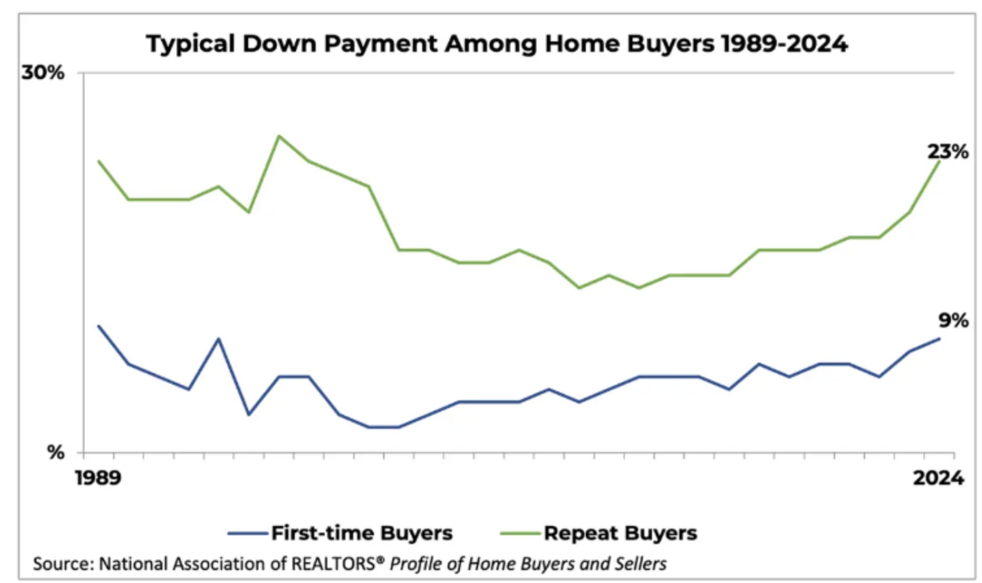
One big question, broken into three
“Can a median-income family afford the median listing in the 100 largest metros as of September 2026, and if not, what has to change?”
1
Is it affordable with 20% down?
2
Is it still affordable with 10% down?
3
If not, what would have to change?
Notes:
I turned my concern into one measurable question and split it into three subquestion, a smaller scale that could answer much more effectively and easier.
Q1 uses NAR's standard index, 20% down payment Principal & Interest no greater than 25% of family income.
Q2 same metric but down payment is now 10%, the median first-time buyer down payment according to NAR => we want to use a realistic case in this scenario
Q3 If they can't afford what would have to change. Is it PRICE / INCOME / Interest RATES

Slide 4
Three public sources and NAR's own formula
Ingredient | Source | What I used
Price | Realtor.com metro inventory | Median listing price, September 2026
Rate | Freddie Mac 30-year fixed (FRED) | Weekly rates averaged to monthly: 6.86%
Income | Census ACS 2024, table B19113 | Median family income and its margin of error
HAI = median family income ÷ income needed × 100
Loan = Price * (1- down payment)
r = rate % / 100 / 12
Payment = Loan * r /(1-(1+r)^-360
Income needed = Payment * 12 / 0.25
Notes:
One public source per ingredient, joined on the government metro ID and month. I used NAR's own HAI formul

Slide 5
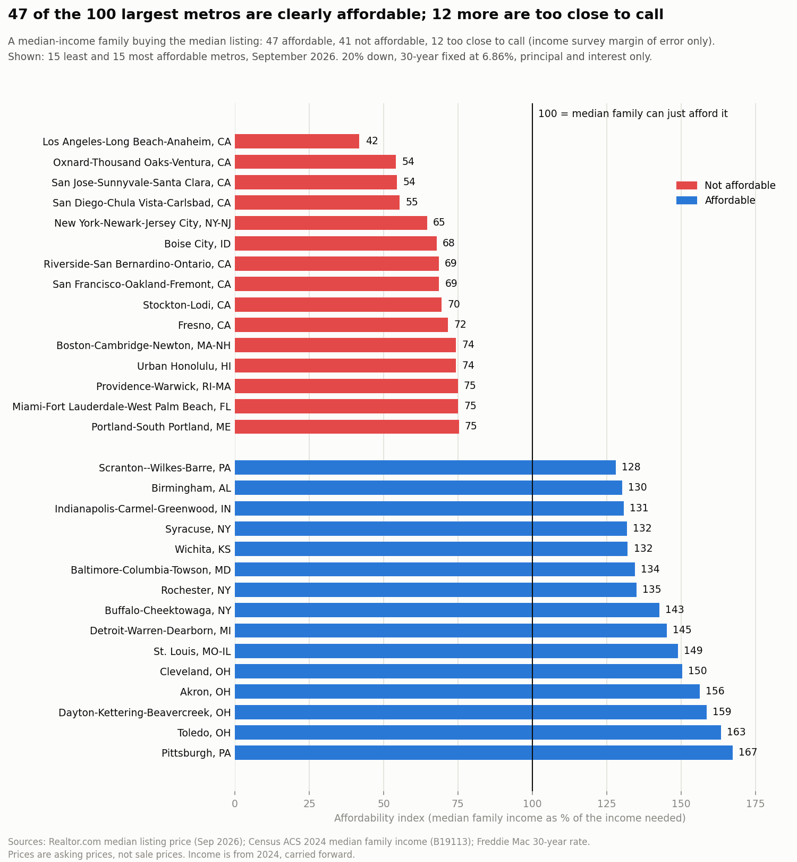
With 20% down, P&I < 25% of their income
47 of the 100 metros are clearly affordable
47
clearly affordable
12
too close to call
41
clearly not affordable
The median metro scores 103, just over the line. Los Angeles is least affordable (42); Pittsburgh is most affordable (167).
Notes:
With NAR's standard 20% down, P&I < 25%.
If a index score above 100, which mean affordable,
< 100 is less affordable based on median income of that metro.
47 of the 100 largest metros are clearly affordable, 41 are not, and 12 are too close to call,
As you can see on the right side LA is least affordable at 42 HAI Score; most affordable, with Pittsburgh at 167.

Slide 6
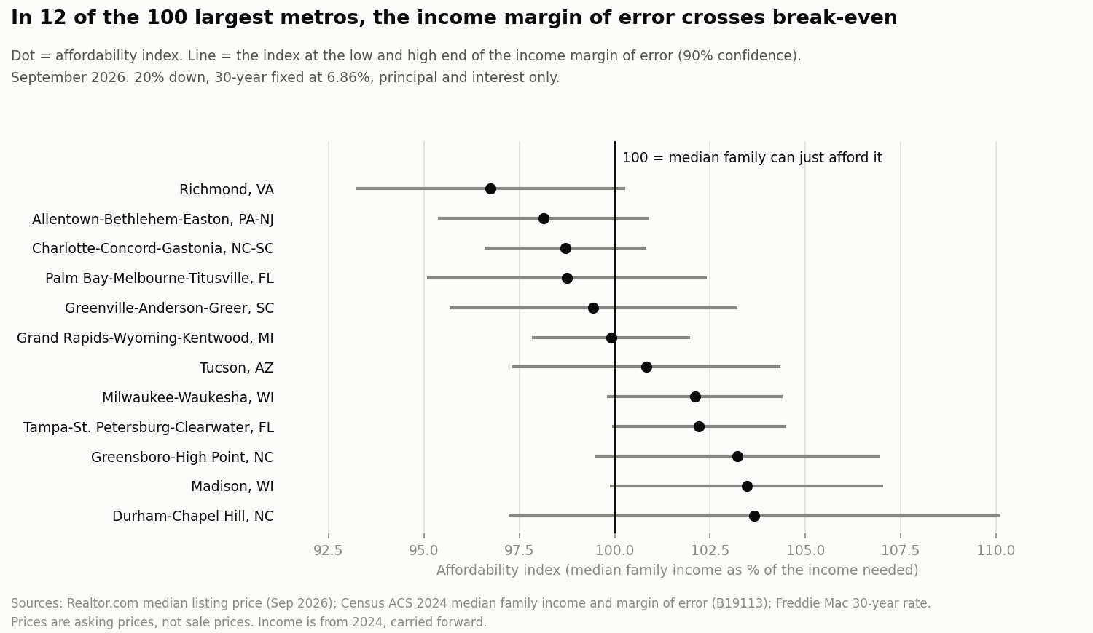
For 12 metros, the honest answer is “too close to call”
Census income is a survey estimate, not an exact count.
When its range crosses 100, these metros could fall on either side, so I don't force a yes or no.
Notes:
Why there is a 12 metros too close to call,
is because income census data has MOE and I'm applying the same metric MOE to this results.
So instead of confidently predict affordable or not, I'll put it as too close to call.
Because it would also involving a lot of factor outside of mortgage rates. / housing insurance, taxes

Slide 7
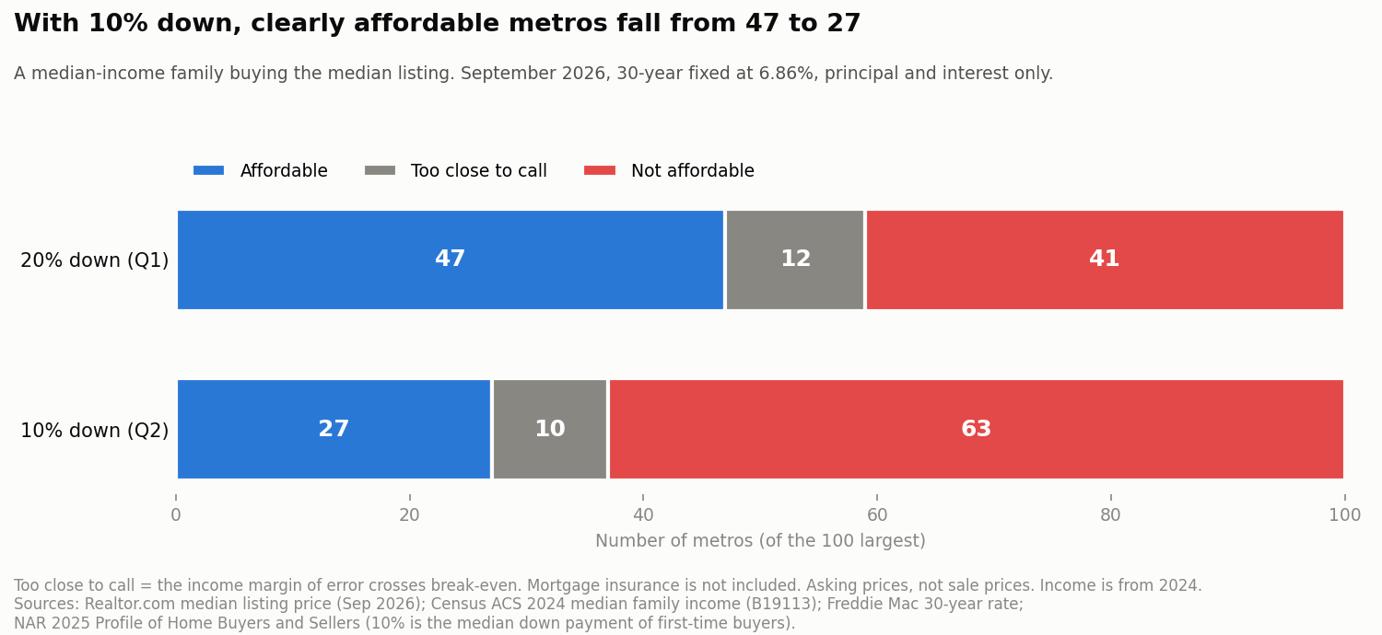
With 10% down, clearly affordable metros fall from 47 to 27
$262
more per month at the median ($144 to $911)
32
metros change verdict
63
not affordable, up from 41
Notes:
With 10%, the typical first-time buyer's down payment,
clearly affordable metros drop from 47 to 27 and not affordable rises to 63 metros.
The extra payment per month is fluctuate around 144 to 911, with 262 a month higher at the median, and 32 metros change
Once again, this result is not including Mortgage insurance, taxes so the real picture is slightly worse.

Slide 8
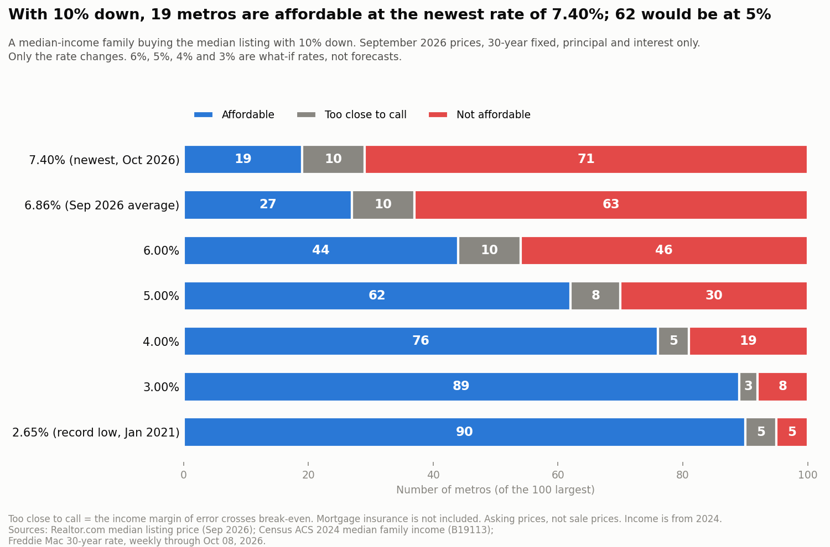
Rates matter most: 19 metros are affordable at 7.40%, 62 at 5%
What it would take, one change at a time
(the 63 metros not affordable at 10% down)
Prices fall about 20% (median)
or incomes rise about 25%
or the rate drops: at 6%, affordable metros rise from 27 to 44
Notes:
Again, using the same metric, with 10% down payment, but this time, the interest rate is changing
For the 63 unaffordable metros, prices would need to fall about 20% at the median, or incomes rise about 25%.
Affordable metro based on MORTGAGE rate, as the rates dropped, the affordable metro picture became much more clearer.
Since I do not have any additional data like most current sales, income of 2025 or even 2026 to developing my own model to determine which factor contributing most to a buyer decision.
Therefore I can concluded that mortgage rate have a significant influence in a buyer would purchase a home.

Slide 9
Recommendations
NAR RESEARCH
Publish a monthly, metro-level listing index as an early signal next to the official HAI
REALTORS
Watch rates in metros near break-even, and tell buyers when a metro crosses 100
FIRST-TIME BUYERS
Make down-payment help a core part of first-time buyer guidance
Notes:
Three recommendations.
For NAR : publish a monthly, metro-level listing-based index as an early signal next to the official one, because based on the data that I has, index is based on closed sales, not current listing price. Also inform realtors about potential market so that its member can be prepare.
For Realtors: watch rates and index score in metros near break-even closely
Because instead of put down 20%, a 10% down payment would increase monthly payment at the median being $262 per month, etc.

